Slide 1

THE HINDU SENIOR SECONDARY SCHOOL
Teacher- Mentor: Mrs. SRIVIDHYA
Team Members:
1. S R ABHISHEK
2. THARUN
3. YASHWANTH

Slide 2

Problem Statement
Today in this social world, there is a lack of safety for women and children. Many kidnaps for their organs are happening in the country. The great step initiated by the Tamil Nadu Government to control crime in the state is the "Kaavalan SOS" Application. This application for Women and Children is an SOS app. When a person is in danger, they will start the 5-second countdown when the "SOS button" on the homepage of the Phone is clicked by the victim.
Then the information of the victim ie, Name, and location details will be sent to the Kaavalan team along with the live video captured by the rear camera of the Victim's Mobile. The Police patrol arrives at the spot within 4 minutes.
The problem is, what will happen if anything dangerous occurs to a victim within those 4 minutes before the arrival of the police??

Slide 3
Our Idea
In this Technological world, Robots are becoming the future of the world. Especially Automated drones, Humanoid Robots, and Cleaning Robots are going to bring up a change in this modern world.
For the above problem, Using the advancement in technology in the future automated drones are made to fly across the nook and corners of the city for surveillance. When the Victim is in Danger, the victim sends the Information through "Kaavalan SOS", to the required team. This Team sends the automated drones with a robot that is flying those areas and gets rushed up to the spot.

Slide 4
Our Idea
Then, This Robot is packed up with the safety measures to be taken for the victim and an Airsoft Gun & an Anaesthetic Injection gun which makes the criminal faint. The Airsoft Gun shoots bullets which makes the body less vandalize.
If the criminal reaches near the drones, Tasers are activated. These tasers usually generate shockwaves and give a person a mild shock. The Anaesthetic used here is also mild and doesn't cause any harm to the criminal. These Drones are also equipped with camera that captures the action live and passes this information to the patrol. These drones are equipped with the First Aid Kit and other needed medicines in case any injuries happen on the spot.

Slide 5
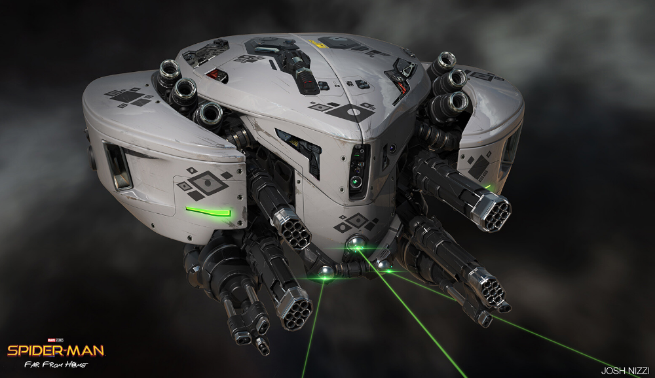
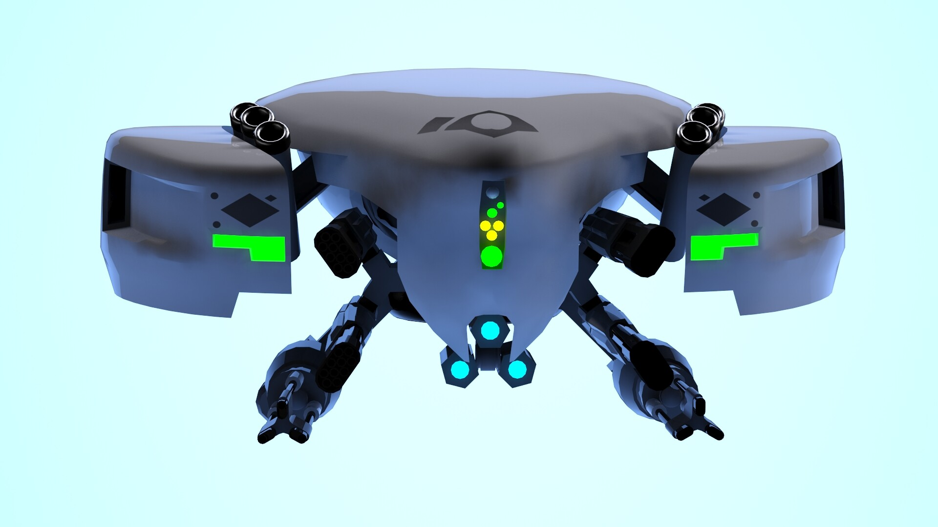
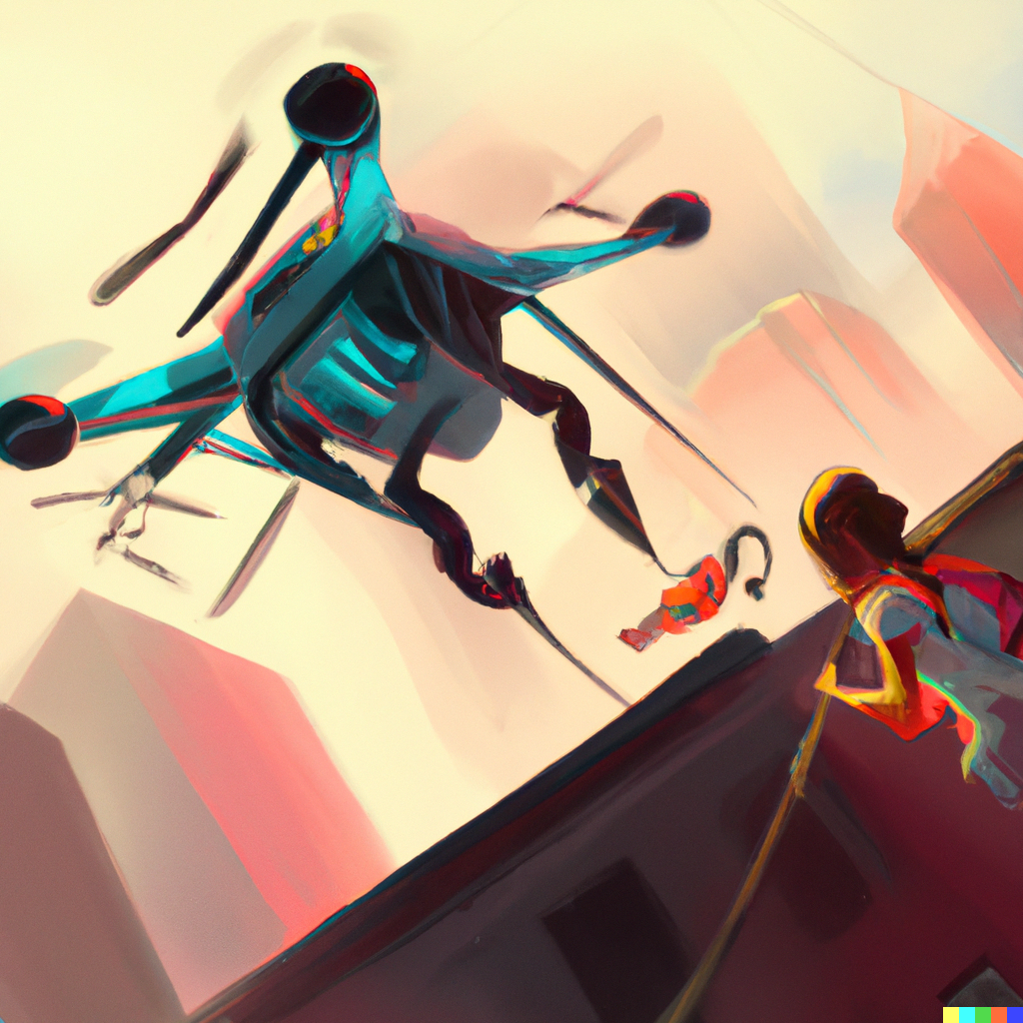

Slide 6
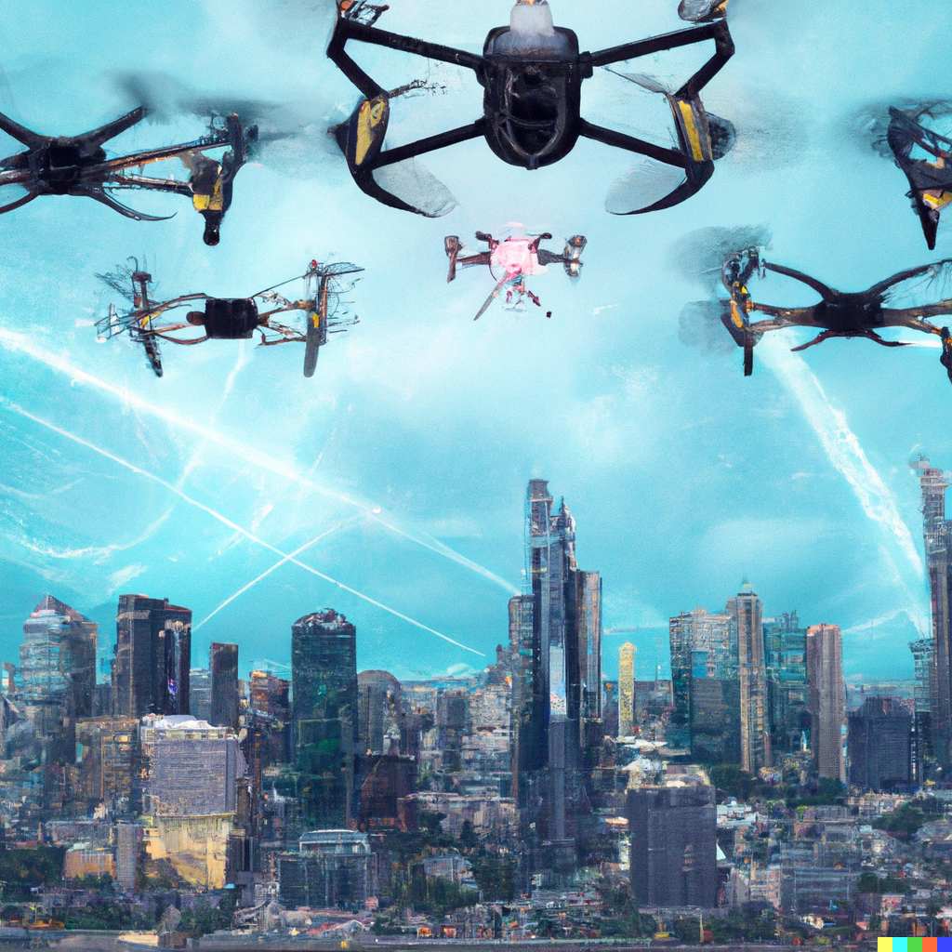
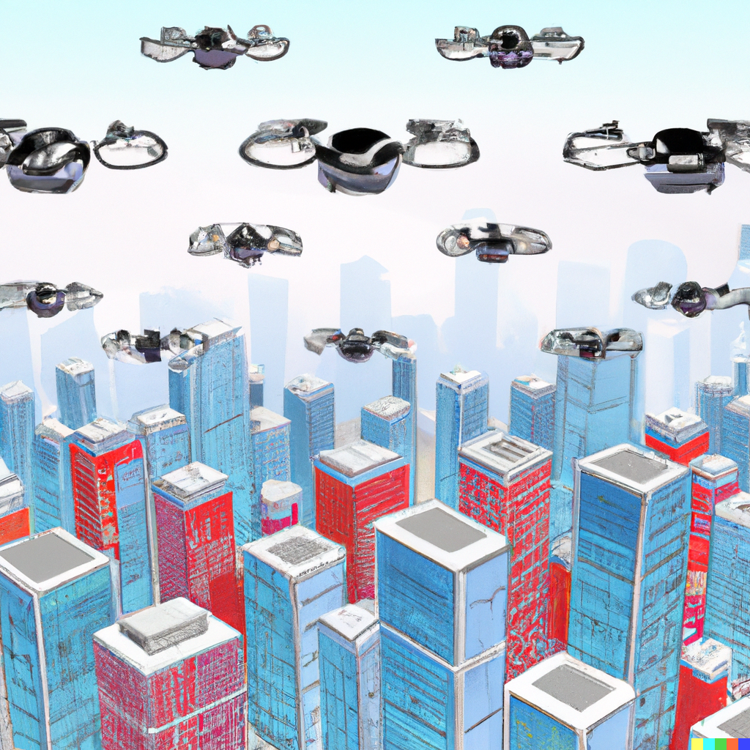
Our Idea
MAJOR ADVANTAGES:-
Already these types of inventions are developing in the world and they can come into practice in some years. So the time taken will be less to come on to practice.
Mainly, Victim's safety is assured till the arrival of the patrol.

Slide 7
Thank You

